Slide 1
Agile principles & Lean Production
COMP6100001 - Software engineering
Session 03
Kenny Jingga, S.Kom., M.T.

Slide 2
Session 03 – Agile principles and Lean PRoduction
Learning objectives
At the end of this session, students will be expected to be able to:
Explain the motivation behind Agile & Lean
Describe Agile Manifesto values & principles
Explain Lean & Kaizen for continuous improvement
Analyze how Agile reduces the cost of change

Slide 3
Session 03 – Agile principles and Lean PRoduction
Content outline
Agile principles
Lean foundations
Agile Manifesto
Kaizen / continuous improvement
Cost of change
Agile mindset (pre-Scrum)

Slide 4
What is Agile?
The ability to create and respond to change
A way to succeed in uncertainty
Focused on adaptiveness, not predictability
Notes:
“Agile is not about speed. Agile is about learning faster when you don’t know everything.”

Slide 5
What Makes Agile Different?
Focus on people and collaboration
Teams are cross-functional
Skills matter more than rigid roles
Practices support coordination and transparency
Notes:
“Agile does not remove management. It changes how management supports teams.”

Slide 6
Agile is A Mindset
Guided by the Agile Manifesto’s values and principles
Helps teams navigate uncertainty
Work in short cycles: try → get feedback → adapt
Notes:
“Agile does not tell you what to do. It helps you decide what to do next.”

Slide 7
Where did Agile ideas come from?

Slide 8
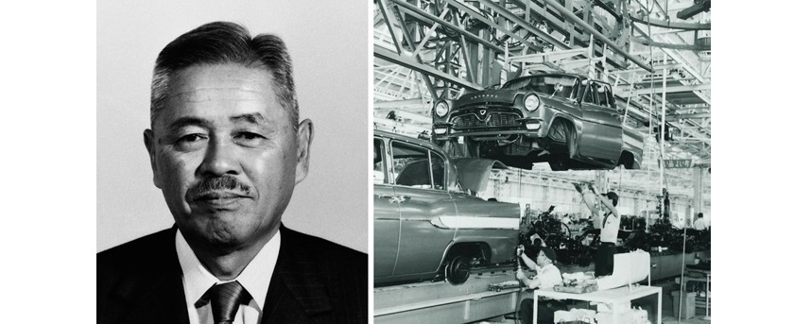
Lean Production
TOYOTA PRODUCTION SYSTEM (TPS)
Late 1940s
Build only what is needed, when it is needed (pull)
Stop and fix problems early (quality first)
Teams are empowered and multi-skilled
Continuous improvement through small changes (Kaizen)
Lean focuses on learning fast and reducing waste
Notes:
Lean focuses on learning fast and reducing waste

Slide 9
Lean Production
From Lean to Agile
Lean Thinking | Agile Software Development
Pull system | Deliver in small increments
Stop to fix defects | Continuous testing & feedback
Empowered workers | Self-organizing teams
Continuous improvement | Retrospectives & adaptation
Agile applies Lean thinking to software development
Notes:
Lean focuses on learning fast and reducing waste

Slide 10
Agile Manifesto

Slide 11
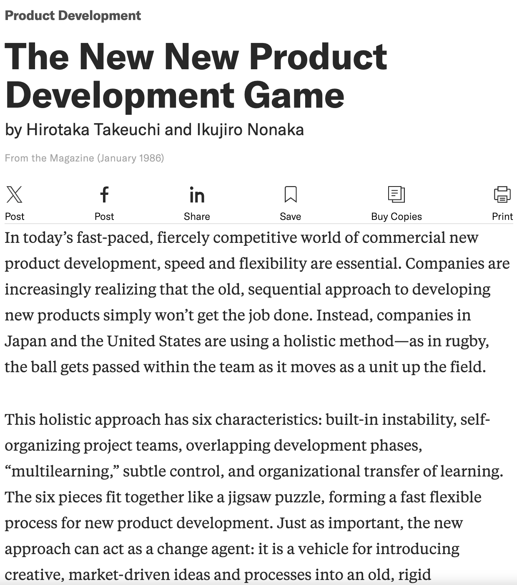
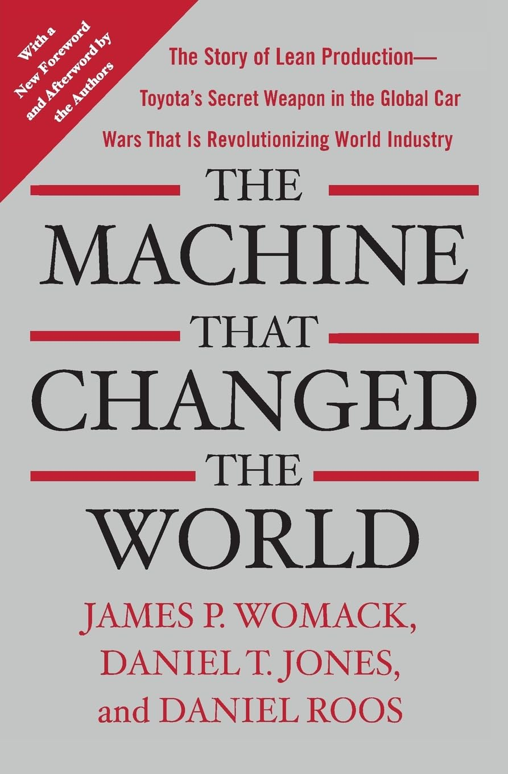
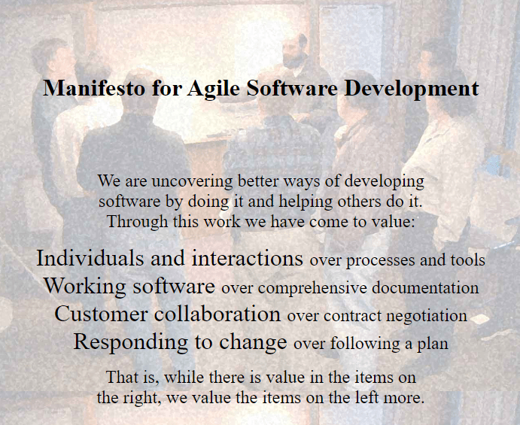
AGILE Manifesto and Principles
Evolution to agile manifesto
…
1986
https://hbr.org/1986/01/the-new-new-product-development-game
1990
2001

Slide 12
Agile Manifesto
12 Principles Behind the Agile manifesto
  Highest priority is to satisfy the customer through early and continuous delivery of valuable software.
  Welcome changing requirements, even late in development. Agile processes harness change for the customer’s competitive advantage.
  Deliver working software frequently, from a couple of weeks to a couple of months, with a preference to the shorter timescale.
  Businesspeople and developers must work together daily throughout the project.
  Build projects around motivated individuals. Give them the environment and support they need, and trust them to get the job done.

Slide 13
Agile Manifesto
12 Principles Behind the Agile manifesto
  The most efficient and effective method of conveying information to and within a development team is face-to-face conversation.
  Working software is the primary measure of progress.
  Agile processes promote sustainable development. The sponsors, developers, and users should be able to maintain a constant pace indefinitely.
  Continuous attention to technical excellence and good design enhances agility.
  Simplicity, the art of maximizing the amount of work not done, is essential.
  The best architectures, requirements, and designs emerge from self-organizing teams.
  At regular intervals, the team reflects on how to become more effective, then tunes and adjusts its behavior accordingly.

Slide 14
Agile Development is adaptive rather than predictive; people-oriented rather than process-oriented. —Martin Fowler

Slide 15
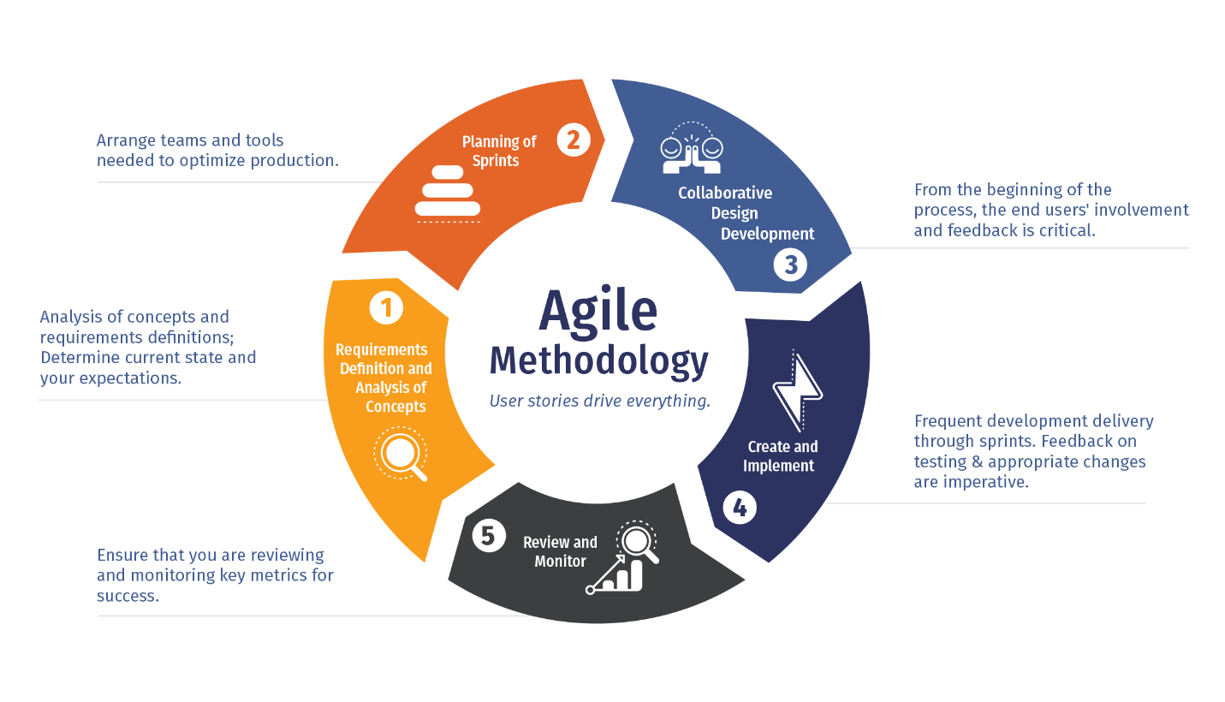
Agile methodology

Slide 16
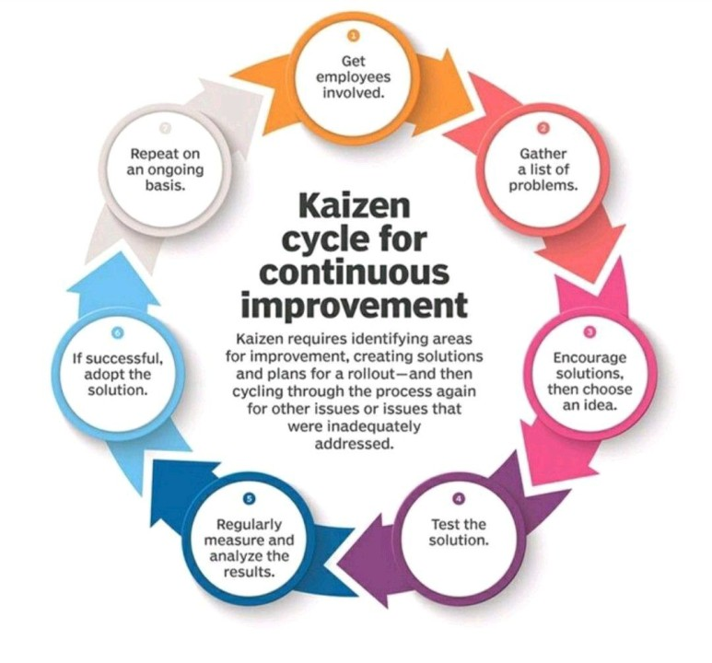
Kaizen cycle
For Continuous improvement

Slide 17
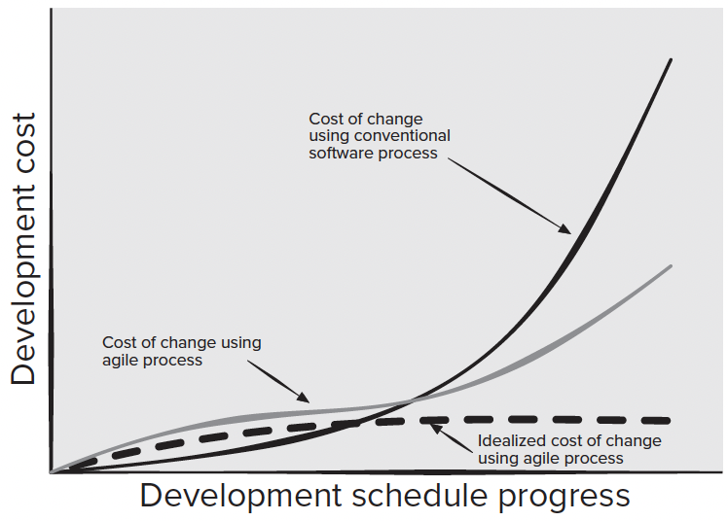
The Process
Agility And The Cost of Change

Slide 18
AGILE Framework: Scrum
Scrum
Originally proposed by Schwaber and Beedle
Scrum—distinguishing features
  Development work is partitioned into “packets”
  Testing and documentation are on-going as the product is constructed
  Work occurs in “sprints” and is derived from a “backlog” of existing requirements
  Meetings are very short and sometimes conducted without chairs
  “demos” are delivered to the customer with the time-box allocated

Slide 19
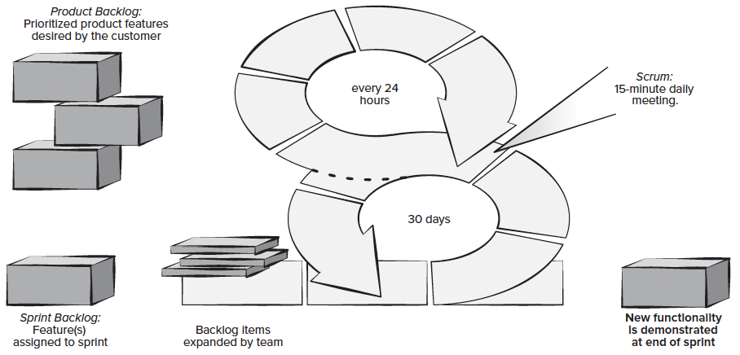
Agile Framework: Scrum
Scrum

Slide 20
Agile Frameworks: Kanban
Description
The Kanban method is a lean methodology that describes methods for improving any process or workflow, focused on change management and service delivery
6 core practices:
  Visualizing workflow using a Kanban board
    The Kanban board is organized into columns representing the development stage for each element of software functionality. The cards on the board might contain single user stories or recently discovered defects on sticky notes and the team would advance them from “to do,” to “doing,” and “done” as the project progresses.
  Limiting the amount of work in progress (WIP) at any given time
    Developers are encouraged to complete their current task before starting another. This reduces lead time, improves work quality, and increases the team’s ability to deliver software functionality frequently to their stakeholders.
  Managing workflow to reduce waste
    Understanding the current value flow, analyzing places where it is stalled, defining changes, and then implementing the changes.
  Making process policies explicit
    (e.g., write down your reasons for selecting items to work on and the criteria used to define “done”).
  Focusing on continuous improvement
    Creating feedback loops where changes are introduced based on process data and the effects of the change on the process are measured after the changes are made
  Make process changes collaboratively
    Involve all team members and other stakeholders as needed.

Slide 21
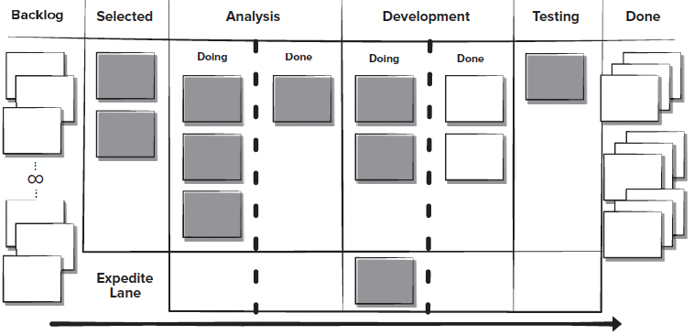
Agile Frameworks: Kanban
Kanban Boards

Slide 22
Agile Frameworks: XP Programming
Agile Framework: XP Programming
XP Planning
  Begins with the creation of “user stories”
  Agile team assesses each story and assigns a cost
  Stories are grouped to for a deliverable increment
  A commitment is made on delivery date
  After the first increment “project velocity” is used to help define subsequent delivery dates for other increments
XP Design
  Follows the KIS principle
  Encourage the use of CRC cards
  For difficult design problems, suggests the creation of “spike solutions”—a design prototype
  Encourages “refactoring”—an iterative refinement of the internal program design
XP Coding
  Recommends the construction of a unit test for a store before coding commences
  Encourages “pair programming”
XP Testing
  All unit tests are executed daily
  “Acceptance tests” are defined by the customer and executed to assess customer visible functionality

Slide 23
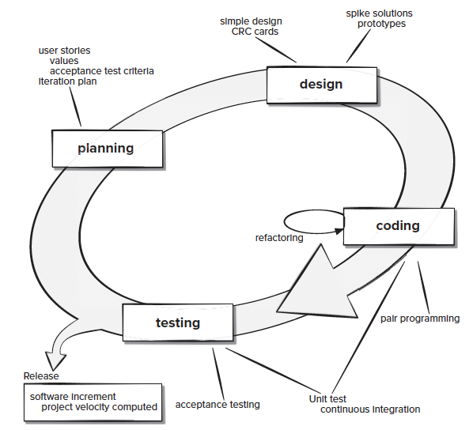
Agile Frameworks: XP Programming
Agile Framework: XP Programming

Slide 24
Agile Frameworks: DevOps
Agile Framework: Devops
DevOps was created by Patrick DeBois to combine Development and Operations. DevOps attempts to apply agile and lean development principles across the entire software supply chain.
The DevOps approach involves several stages that loop continuously until the desired product exists:
  Continuous development
    Software deliverables are broken down and developed in multiple sprints with the increments delivered to the quality assurance14 members of the development team for testing
  Continuous testing
    Automated testing tools are used to help team members test multiple code increments at the same time to ensure they are free of defects prior to integration.
  Continuous integration
    The code pieces with new functionality are added to the existing code and to the runtime environment and then checked to ensure there are no errors after deployment.
  Continuous deployment
    At this stage the integrated code is deployed (installed) to the production environment, which might include multiple sites globally that need to be prepared to receive the new functionality.
  Continuous monitoring
    Operations staff who are members of the development team help to improve software quality by monitoring its performance in the production environment and proactively looking for possible problems before users find them.

Slide 25
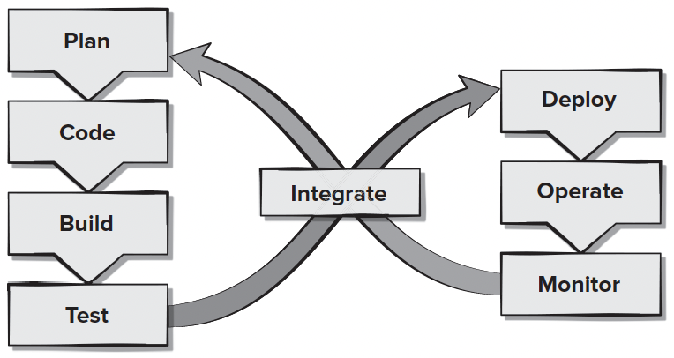
Agile Frameworks: DevOps
Agile Framework: Devops

Slide 26
References
Titus Winters, Tom Manshreck, and Hyrum Wright. (2020). Software Engineering at Google: Lesson Learned from Programming Over Time. 1st. O’Reilly Media. California. ISBN: 978-1492082798.
Roger Pressman and Bruce Maxim. (2020). Software Engineering: A Practitioner's Approach. 9th E. McGraw- Hill. New York. ISBN: 9781259872976.
Multimedia : Video Water Fall, V model, http://www.youtube.com/watch?v=KaPC0gsEQ68
Software Engineering Incremental Model, http://www.youtube.com/watch?v=9cBkihYP1rY
The Strengths and Weaknesses of Extreme Programming, http://www.youtube.com/watch?v=LkhLZ7_KZ5w
Agile project management tutorial: What is agile project managemen, http://www.youtube.com/watch?v=MJR-EgHTA4E

